Slide 1
Learning Representations of Large-Scale Networks
Jian Tang
HEC Montréal
Montréal Institute for Learning Algorithms (MILA)
tangjianpku@gmail.com
Acknowledgment: Meng Qu, Jingzhou Liu, Mingzhe Wang,
Ming Zhang, and Qiaozhu Mei

Slide 2
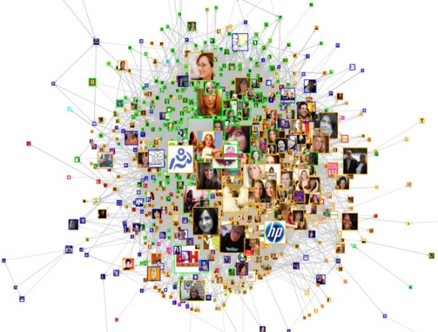
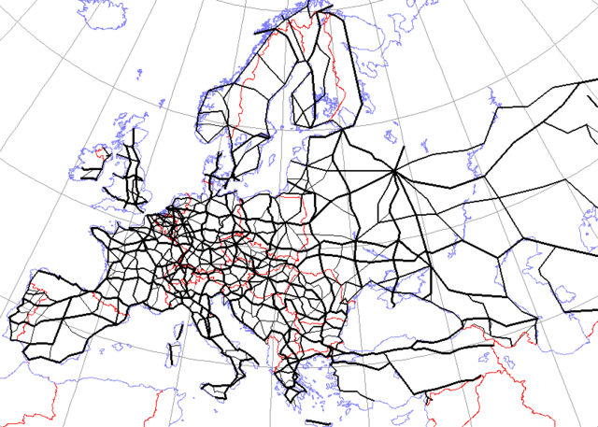
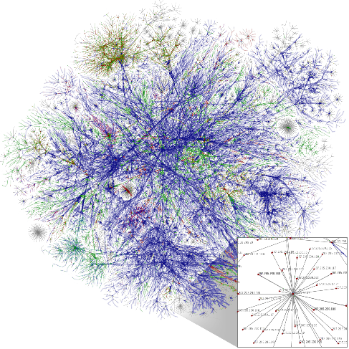
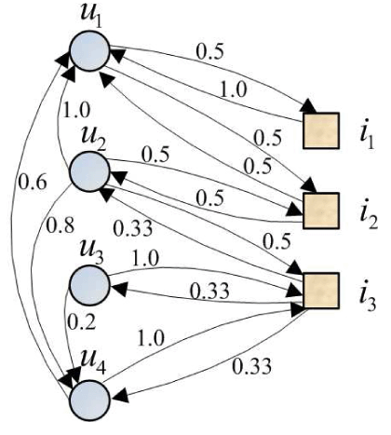
Networks
Ubiquitous in real world
Social Network
Road Network
World Wide Web
User-item network
A flexible and general data structure
Many types of data can be formulated as networks
Notes:
Let’s start by introducing the motivation of studying networks. Networks encode relationships between different objects and are ubiquitous in real world. For example, social networks encode the social relationship between users; citation networks encode the citing relationship between papers; the World Wide Web represents the hyperlink between Webpages. In the future, everything will be connected, which is known as Internet-of-Things. Besides, network is a very flexible and general data structure, and many data can be reformulated as networks. Therefore, if we
can solve problems on networks, many problems on other data can be solved as well.

Slide 3
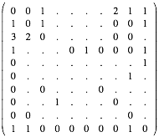
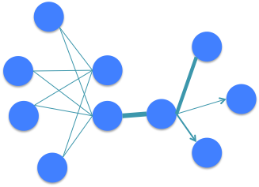
Traditional Representations of Networks
Suffer from data sparsity
Suffer from high dimensionality
Does not facilitate computation
Does not represent “semantics”
…
Notes:
To analyze networks, the first step is to effectively represent networks, which largely determine the performance of many follow up tasks on networks. You may think this is very easy by simply representing networks as adjacency matrices. However, this type of representations suffers from serious problem of data sparsity and high-dimensionality, which does not facility computation for network analysis. Meanwhile, it do not represent any semantics, making it difficult to understand networks.

Slide 4
Research Question and Challenges
How to effectively and efficiently represent networks?
Challenges:
Large-scale: millions of nodes and billions of edges
Heterogeneous: directed/undirected, and binary/weighted
Notes:
Therefore, the research question I try to answer is: how to effectively and efficiently learn the representation of networks?
This is a very challenging problem since real-world networks are very large-scale, which usually contain millions of nodes and billions of edges or even beyond this. Besides, Real-world networks are also heterogeneous. The edges of networks can be directed, undirected, binary, or, weighted.
In machine learning literature, although there are many work study learning representations of images, speeches or natural languages, there is little work on learning representations of networks.

Slide 5
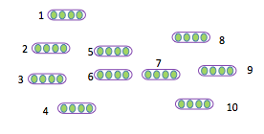

Learning Node Representations for Networks
Node Classification
Node Clustering
Link Prediction
Recommendation
…
Network
Node representations
E.g., Facebook social network -> user representations (features)-> friend recommendation
Text representation, e.g., word and document representation, …
degree
document
Deep learning has been attracting increasing
attention …
node
A future direction of deep learning is to integrate
unlabeled data …
network
text
word
Word representation
…
edge
The Skip-gram model is quite effective and efficient …
…
embedding
classification
Unstructured text
Word co-occurrence network
Notes:
My research focuses on learning node representations for networks. Given a large-scale network, the goal is to represent the nodes in low-dimensional spaces. Each node is represented with a low-dimensional vector, and the similarities between the nodes are preserved in the low-dimensional space. The node representations can be potentially useful in a variety of applications such as node classification and recommendation. Take the social network between users in Facebook as a concrete example. By learning the representations of the social network, each user will be represented as a low-dimensional vector, which can be used as features for the users. Then we can calculate the similarities between the users with the low-dimensional vectors. Based on the similarities, we can recommend similar users or friends to each user.
Since network is very general and flexible, learning node representations of networks can be applied to other applications as well. For example, we can construct the networks between words, the word co-occurrence networks, from unstructured text. By learning the representations of word co-occurrence networks, we are able to obtain word representations, which can be effective features for many natural language processing tasks.

Slide 6
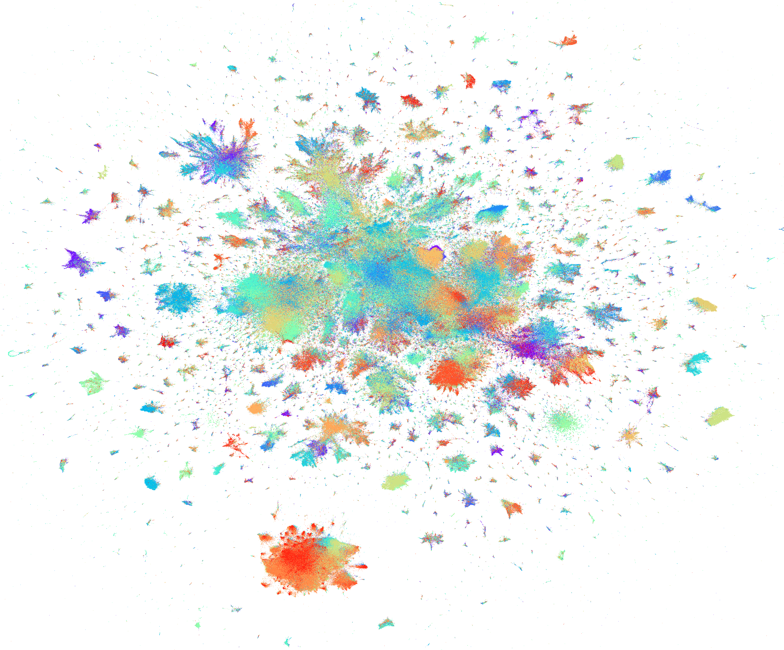
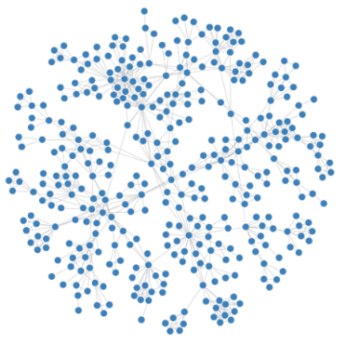
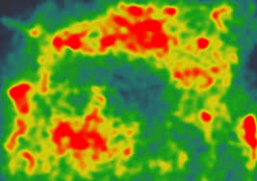
Extremely Low-dimensional Representations: 2D/3D for Visualizing Networks
….
….
….
….
….
….
….
High-dimensional Data
Networks
2D/3D Layout
Scatter Plots
Network Diagrams
Heatmaps
Notes:
When the dimensionality of the node representations becomes extremely small, for example, two or three dimensions, we are able to visualize the networks into two-dimensional or three-dimensional spaces. These low dimensional representations can be used for a variety of purposes. For example, they can be used as coordinates to build advanced visualizations to show the global characteristics of networks.
Again, since networks are very general and flexible. This can be generalized to visualize any high-dimensional data by first constructing networks from high-dimensional data, for example, K-nearest neighbor graph.

Slide 7
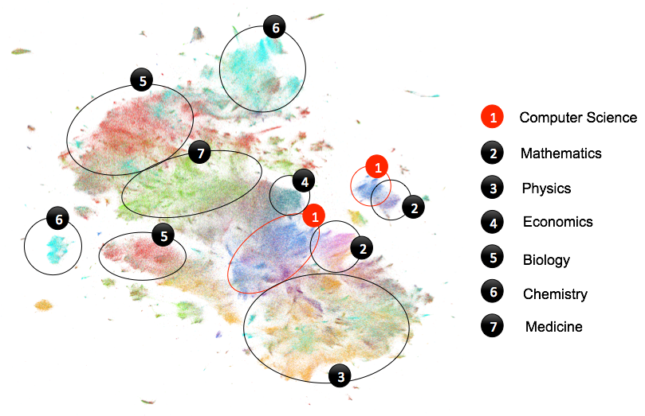
Visualizing Scientific Papers
10M Scientific Papers on One Slide
Notes:
For example, this is a visualization of 10M scientific papers on one slide. Each data point is a paper, different colors corresponds to different subjects. We will come back to this visualization later.

Slide 8
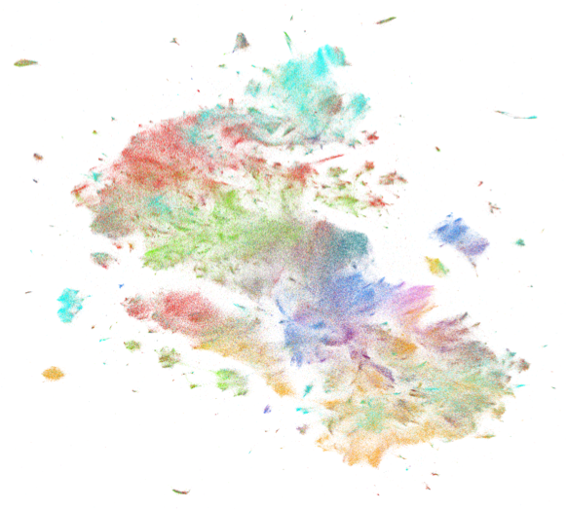

Roadmap
Learning Node Representations
for Networks
Visualizing Networks
Future Plan
Notes:
The rest of my talk is organized as follows. I will first talk about learning node representations for networks. Then I will introduce how to learn extremely low-dimensional-representations, 2D/3D representations for visualizing networks. Finally, I will discuss my future plans.

Slide 9
A very Challenging Problem!
Networks
Node representations
Large-scale
millions of nodes and billions of edges
Heterogeneous
directed, undirected, and/or weighted
Notes:
The goal of learning node representation of networks is to represent each node with a low-dimensional vector. As just said, it is a very challenging problem since real-world works are very large-scale and heterogeneous. The types of edges can be different: directed, undirected, and/or weighted.

Slide 10
Related Work
Classical graph embedding algorithms
MDS, IsoMap, LLE, Laplacian Eigenmap, …
Hard to scale up
Graph factorization (Ahmed et al. 2013)
Not specifically designed for network representation
Undirected graphs only
Neural word embeddings (Bengio et al. 2003)
Neural language model
word2vec (skipgram), paragraph vectors, etc.
DeepWalk (Perozzi et al. 2014)
Lacks a clear objective function
Binary edges only
Notes:
In literature, there are some related work such as the classical graph embedding algorithms multi-dimensional scaling, IsoMap, and Laplacian Eigenmap. These algorithms work well on small networks. However, they are difficult to scale up to real-world networks. There are some work based on graph factorization, which is able to scale up to very large networks. But the objective of graph factorization is not specifically designed for network representation, and it is only applicable for undirected edges.
Network representation is also related to neural word embeddings, which studied learning word representations from word sequences. Our focus is learning node representations from networks with arbitrary structures.
The most related work with us is DeepWalk, which also studied learning node representations of networks. However, DeepWalk does not have a clear objective function, and is only applicable for networks with binary edges.

Slide 11
LINE: Large-scale Information Network Embedding (Most Cited Paper of WWW 2015)
Arbitrary types of networks
Directed, undirected, and/or weighted
Clear objective function
Preserve the first-order and second-order proximity
Scalable
Asynchronous stochastic gradient descent
Millions of nodes and billions of edges: a coupe of hours on a single machine
Notes:
I proposed a scalable model called LINE for learning node representations, which is applicable for various types of networks including directed, undirected and weighted. It has a clear objective function, which preserves the first and second-order proximity between the vertices. I’ll introduce the definition of the two proximity later. LINE is very scalable, which has a very effective and efficient optimization algorithm through asynchronous stochastic gradient descent. It only takes a couple of hours to learn the representation of networks with millions of nodes and billions of edges on a single machine.
Coming back to the objective of network representation? What is the right objective of network representation? Or in other words, what can we say about a good representation? It is natural to assume that under a good representation, the similarities of nodes should preserve the proximity of the nodes on the original network. Here, the proximity can be interpreted differently.

Slide 12
First-order Proximity
The local pairwise proximity between the nodes
However, many links between the nodes are not observed
Not sufficient for preserving the entire network structure
Notes:
One type of proximity is the first-order proximity, which is the local pairwise proximity and determined by the observed links. For vertices without links, their first-order proximity is 0. First-order proximity has been exploited by many existing graph embedding algorithms. However, many links between the vertices in real-world networks are not observed. Therefore, using first-order proximity is not sufficient for preserving the network structures. An alternative proximity must be provided.

Slide 13
Second-order Proximity
“The degree of overlap of two people’s friendship networks
correlates with the strength of ties between them”
--Mark Granovetter
“You shall know a word by the company it keeps”
--John Rupert Firth
Proximity between the neighborhood structures of the nodes
Notes:
Therefore, we introduce the second-order proximity between the vertices, which is the proximity between the neighborhood structures of the vertices. The intuition is that nodes sharing similar neighbors are likely to be similar to each other. For example, in a social network people who share many common friends are likely to share similar interest; Another example is that words that are used together with many similar words are likely to have similar meanings. Next I will introduce how to preserve the first-order and second-order proximity in the low-dimensional space.

Slide 14
Preserving the First-order Proximity (LINE 1st)
Distributions: : (defined on the undirected edge i - j)
Empirical distribution of first-order proximity:
: Embedding of i
Model distribution of
first-order proximity:
Objective:
Notes:
I first define the empirical distribution of first-order proximity. For each pair of node i and j, the empirical distribution of first-order proximity between node i and j is defined as the weight of the edge between the two nodes and normalized by the weights of all the edges in the network. I also define a distribution of the first-order proximity based on the node representations using the softmax function. Here the vector u_i is the representation of node i. To preserve the first-order proximity, a straightforward way is to minimize the distance between the empirical distribution of the first-order proximity and the model distribution of the first-order proximity based on the node representations. For the distance between the distributions, we adopt the commonly used KL-divergence. The final objective function can be simplified as the negative log-likelihood of the observed undirected links.

Slide 15
Preserving the Second-order Proximity (LINE 2nd)
Distributions: (defined on the directed edge i -> j)
Empirical distribution of neighborhood structure:
Model distribution of neighborhood structure:
Objective:
Notes:
As introduced previously, the second-order proximity between the nodes is determined by the proximity of their neighborhood structures. Therefore, we first define the neighborhood structures for each node . Empirically, for a node i, we define the probability from node i to its neighbor j as the weight of the edge between the two nodes w_ij and normalized by the weights of the edges in the neighborhood. Similarily, we can also define a distribution of the neighborhood structures based on node representations using a softmax function. Therefore, to preserve the second-order proximity, we only need to preserve the neighboorhood structures for all the vertices. KL-divergence is still used to measure the distance between the empirical distribution and model distribution of the neighborhood structure. The final objective can be simplified as the negative log-likelihood of the directed links.

Slide 16
Optimization Tricks
Stochastic gradient descent + Negative Sampling
Randomly sample an edge and multiple negative edges
The gradient w.r.t the embedding with edge (i, j)
Problematic when the variances of weights of the edges are large
The variance of the gradients are large
Solution: edge sampling
Sample the edges according to their weights and treat the edges as binary
Complexity: O(d*K*|E|)
Linear to the dimensionality d, the number of negative samples K, and the number of edges
Notes:
For optimization, we use the stochastic gradient descent and negative sampling techniques. In each step, an edge and multiple negative edges are sampled for model updating. More specifically, given an edge (i,j), the gradient w.r.t. the embedding of vertex v_i can be calculated as follows. We can see that the gradient will be multiplied by the weights of the edges. This will be problematic when the variants of the weights of the edges are very large. Because in this case, the variance of the gradients are very large, which make the optimization process very unstable. This problem can be solved if the weights of all the edges for training are equal. Therefore, we propose an approach of edge sampling, which samples an edge with the probability proportional to its weight and treat the sampled edge as binary. With the edge sampling approach, the overall objective function remains the same. The overall complexity of the optimization is linear to the size of the low-dimension d, the number of negative samples K, the number of edges |E|

Slide 17
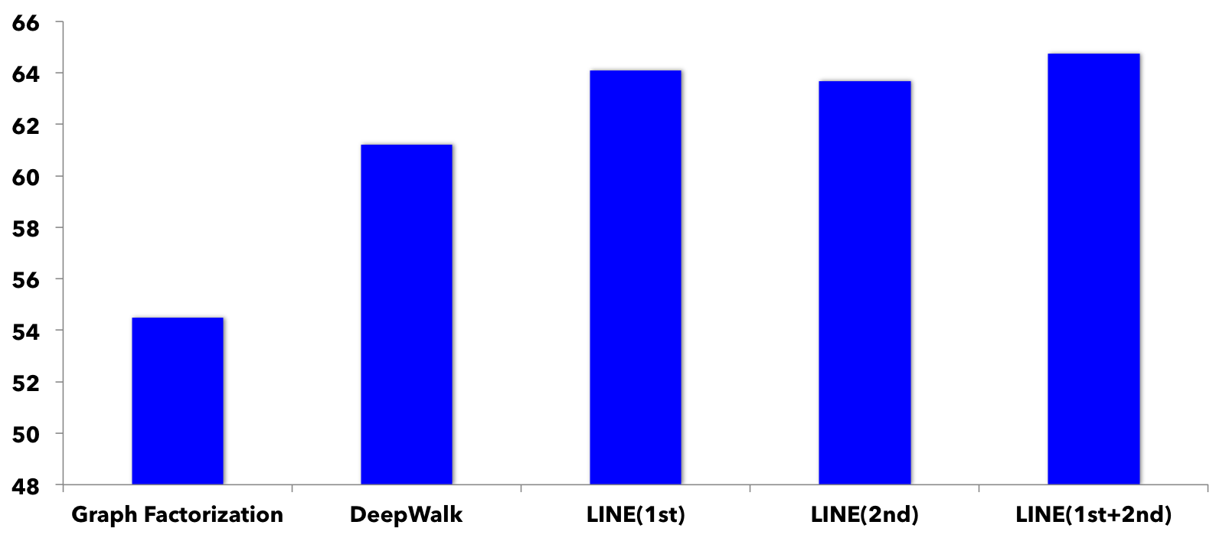
Application 1: Social Network Representation (User Classification)
social network => user representations (features) => classifier
Community identities as classification labels
Accuracy
LINE(1st+2nd)>LINE(1st)>LINE(2nd )>DeepWalk>GF
Notes:
Now let’s look at some results on real-world data. We apply the LINE model to learn the node representations of social networks. By learning the representations of social networks, each user will be represented as a low-dimensional vectors. Then we evaluation the quality of the representations using the task of user classification, in which the communitiy identties are used as classification as lablels and the user represented are treated as features of the users.
These are the results on the Flick social network. We can see the LINE with first-order proximity outperforms LINE with second-order proximity. LINE with second-order proximity outperforms DeepWalk and Graph factorization. The combination of LINE with both first-order and second-order proximity yields the best performance.

Slide 18
Application 2: Unsupervised Text Representation
Construct text networks from unstructured text
degree
document
Text representation, e.g., word and document representation, …
node
network
word
text
Word co-occurrence network
Deep learning has been attracting increasing
attention …
edge
A future direction of deep learning is to integrate
unlabeled data …
embedding
classification
…
The Skip-gram model is quite effective and efficient …
Information networks encode the relationships
between the data objects …
text
doc_1
information
doc_2
Unstructured text
network
doc_3
Word-document network
word
doc_4
…
…
classification
…
Notes:
We also apply the LINE model for learning unsupervised text representations. We first convert the unstructured text into different types of text networks . For example, the word co-occurrence networks, in which in each node is a word, and the weights of the edges between the words are the number of times the two words co-occur in all the local windows. Another network is the bi-partite network word-document network, in which the weights of the edges between a word and a document is the frequency of the word in the document. By representing the word co-occurrence network, we can obtain word representations. By representing word-document network, we can obtain both word and document representations.

Slide 19
Task 1: Word Analogy
Entire Wikipedia articles => word co-occurrence network (~2M words, 1B edges)
Size of word co-occurrence networks does not grow linearly with data size
Only the weights of edges change
Algorithm | Semantic(%) | Syntactic(%) | Overall
GF | 61.38 | 44.08 | 51.93
SkipGram | 69.14 | 57.94 | 63.02
LINE(1st) | 58.08 | 49.42 | 53.35
LINE(2nd ) | 73.79 | 59.72 | 66.10
LINE(2nd) > LINE(1st)
LINE(2nd) > SkipGram
Notes:
We learn the word representations by constructing word co-occurrence network from the entire Wikipedia articles, which contains around 2 million words and 1 billion edges. We evaluate the quality of the word representations with the task of word analogy, which is a typical task for word representation evaluation. Results show that LINE with second-order proximity outperforms LINE with first-order proximity. This is very reasonable since two word co-occur does not mean they are similar but two words cooccuring with many common words are more likely to be similar to each other. We are also superisingly to see that LINE with the second-order proximity outperforms the state-of-the-art word representations model Skipgram, which learns word representation directly from free text. The reason is that the word co-occurrence network contains the global structures of word coocurrences compared to unstructured free text. Another advantage of our approach is that the complexity of the algorithm does not grow linearly with data size since when the data increases, the size of word co-occurrence networks will not grow and only the weights of the edges between the words change.

Slide 20
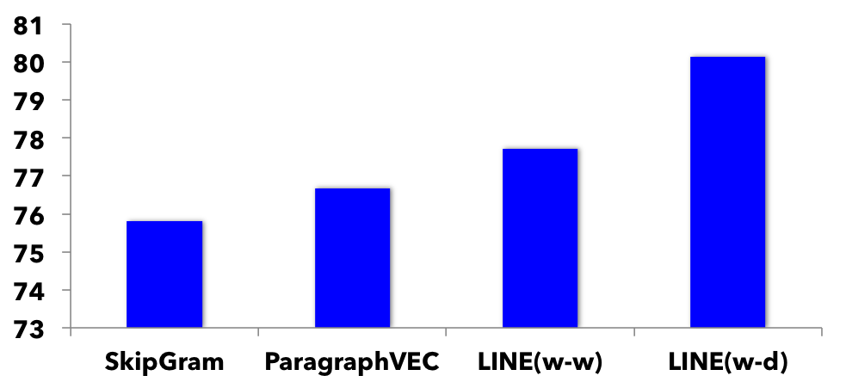
Task 2: Text Classification (on Long Documents)
Word co-occurrence network (w-w) , word-document network (w-d) to learn the word embedding
Document embedding as average of word embeddings in the document
Accuracy
LINE(w-w) > SkipGram
LINE(w-d) > ParagraphVEC
LINE(w-d) > LINE(w-w)
Notes:
We evaluate the quality of the word representations with the task of text classification. We learn the word representations either with the word co-occurrence network or word-document network. Once we get the word representations, we take the average of the word representation in the documents are the document representations, which are used as features for document classification. On three different data sets, we can see that LINE with word co-occurrence network outperforms Skipgram, both of which use local context-level word cooccurrences. LINE with word-document network outperforms PargaphVEC, both of which uses document-level word co-occurrences. We can also see that word representations with word-document networks outperforms with word cooccurrence network.

Slide 21
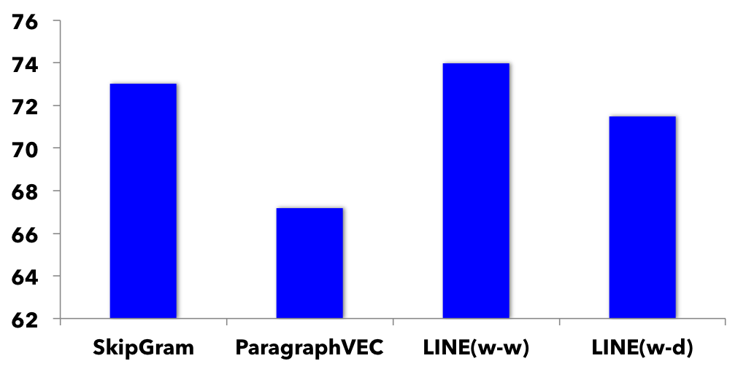
Task 3: Text Classification (on Short Documents)
Word co-occurrence network (w-w) , word-document network (w-d) to learn the word embedding
Document embedding as average of word embeddings in the document
Accuracy
LINE(w-w) > SkipGram
LINE(w-d) > ParagraphVEC
LINE(w-w) > LINE(w-d)
Notes:
We also evaluate the quality of the word representations on short douments. Similar results on observed. LINE with word co-occurrence network outperforms SkipGram. LINE with word-document network outperforms PargraphVEC. However, different from results on long documents, on short documents, LINE with word co-occurrence network outperforms LINE with word-document network. This is because on short documents, the word-document is very sparse.

Slide 22
Summary
LINE: a scalable algorithm for learning node representations of networks
Preserve the first-order and second-order proximity
State-of-the-art results in social network representation and unsupervised text representation
Notes:
To summarize, in this work, we propose a scalable algorithm called LINE for learning node representations of networks. It preserves the first-order and second-order proximity between the vertices and achieves the state-of-the-art results in learning representations for social networks and text representation.

Slide 23
Semi-supervised Text Representation (Tang et al. 2015)
Jointly training word co-occurrence network, word-document network, and word-label network
Document representation as the average word representation
Outperform CNN on long documents and comparable to CNN on short documents
null
Text representation, e.g., word and document representation, …
degree
text
doc_1
text
Deep learning has been attracting increasing …
document
information
doc_2
information
label_1
null
node
network
label_2
null
A future direction of deep learning is to integrate …
network
word
network
doc_3
…
text
word
doc_4
word
label_3
label
The Skip-gram model is quite effective and efficient …
edge
…
…
…
…
label
Information networks encode the relationships
…
classification
…
embedding
classification
classification
label
document
Word co-occurrence
network
Word-document
network
Word-label
network
Unstructured text
Notes:
As mentioned previously, since network is a very general and flexible data representation, LINE can be used to many applications by constructing different types of networks. For example, LINE can be extended for learning semi-supervised text representations. Besides constructing the word cooccurrence networks and word-document networks, we can also construct the networks between words and labels, which encode the supervised information. We learn word representations by jointly training the three networks and then the document representations are simply taken as the average word representations. Results show that this approach outperform convolutional neural networks for text classification on long documents and is comparable or a little bit inferior to CNN on short documents.

Slide 24
Heterogeneous Star Network Representation (Qu, Tang, and Han, 2017)
Heterogeneous Star Networks
Example 1: object: papers, attributes: (authors, conferences, titles)
Example 2: object: movies, attributes: (directors, actors, writers, keywords)
attribute 1
Training data
Different types of edges
Type of edges:a pair between the object
and a type of attribute
object
attribute 2
attribute 3
SGD for training
Sample from different types of edges
How to sample?

Slide 25
Learning the Curriculum via Monte-Carlo Tree Search (MCTS)
Learning the optimal sequence of types of edges for training
Monte-Carlo Tree Search
Balances between exploiting promising sequences and exploring random sequences
State: the sequences of edges of types
Action: select the next type of edges,
Reward: classification accuracy on
validation data

Slide 26
Curriculum Learned via MCTS
Results on a paper-star network
Object: paper, attributes: (authors, citations, words, labels)
Unsupervised
Semi-supervised

Slide 27
Roadmap
Learning Node Representations
for Networks
Visualizing Networks
Future Plan
Notes:
Next, I’m going to talk about how to visualize networks

Slide 28
Visualizing Networks and High-dimensional Data
K-Nearest Neighbor Graph (KNN-G)
Construction
….
….
….
….
….
….
….
High-dimensional Data
Networks
2D/3D Layout
Visualizing high-dimensional data is very challenging for large-scale data
Notes:
Visualizing networks aim to represent each node with a two or three dimensional vector. Since network is a very general data structure, we can use this to visualize any high-dimensional data by constructing a K-nearest neighbor graph from the data and then embed the K-NNG into two-dimensional space. Howeer
However, both the stage of K-Nearest neighbor graph construction and graph layout becomes very challenging when the number of data points very large.

Slide 29
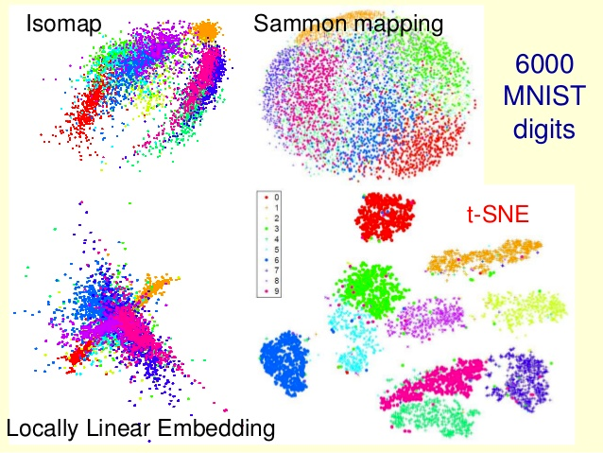
t-SNE (Maarten and Hinton, 2008)
-Image from http://www.slideshare.net/xuyangela/an-introduction-to-tsne
Limitations of t-SNE:
K-NNG construction: complexity grows O(NlogN) to the data dimension
Graph layout: complexity is O(NlogN), where N is the number of data points
Very sensitive parameters
Notes:
In machine learning literature, the state-of-the-art approach for visualizing high-dimensional data is t-SNE, which has been used broadly to visualize different types of data. However, t-SNE suffers from several limitations. In the stage of K-nearest neighbor graph construction, if you want to construct an accurate K-NNG, the complexity grows exponentially to the data dimension. An approximate method must be used. In the stage of graph layout, the complexity of t-SNE with respect to the number of data N is O(NlogN), which can be very expensive when the number of data becomes very large. Besides, the parameters of t-SNE are very sensitive on different data sets. In brief, t-SNE is difficult to scale up to very large-scale data sets.

Slide 30
LargeVis (Best Paper Nomination at WWW 2016)
Efficient approximation of K-NNG construction
30 times faster than t-SNE (3 million data points)
Better time-accuracy tradeoff
Efficient probabilistic model for graph layout
O(NlogN) -> O(N)
7 times faster than t-SNE (3 million data points)
Better visualization layouts
Stable parameters across different data sets
Notes:
We propose a new visualization technique called LargeVis for visualizing large-scale and high-dimensional data. It enjoys a very efficient approach for K-nearest neighbor graph construction, which is thirty times faster than t-SNE on three million data points. It also has a better time-accuracy tradeoff. LargeVis has a very efficient approach for graph visualization, the complexity of which is linear to the number of data points. On three million data points, it is seven times faster than t-SNE. The visualizations generated by LargeVis are also more effective. Besides, the parameters of LargeVis are very stable across different sets.

Slide 31
10M Scientific Papers on One Slide
Notes:
Visualizing high-dimensional data is very important because the visualization is able to intuitively show the global structure of the data, helping us answer many questions that would not be possible without the visualization. For example, if I ask you a question “where do you think computer science locates in the map of all sciences?” You may have no idea. We can answer this question with a visualization – a visualization that maps 10 million scientific papers in one slide. Every data point is a paper, and papers from the same domains form clusters. Every color represents a field. Where is computer science? Over here, pretty central, which is great. It is close to mathematics, physics, and economics. Beside them we can also see big clusters that correspond to biology, chemistry, and medicine, which are close to each other.

Slide 32
10M Scientific Papers on One Slide

Slide 33
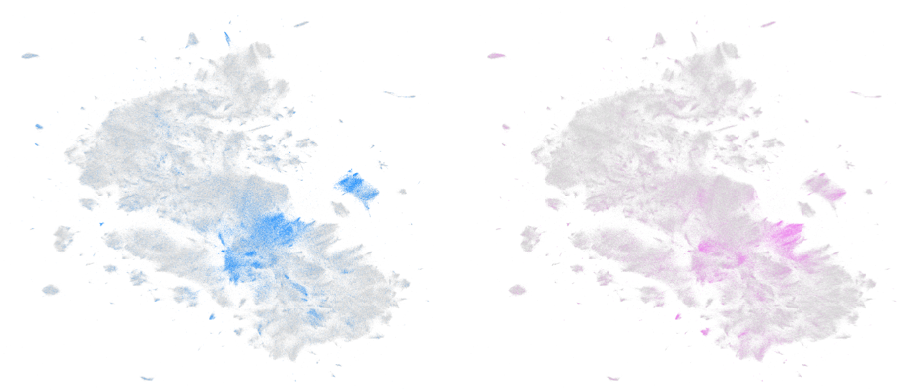
Computer Science
Mathematics
Notes:
We can also take a closer look and compare two fields. Here we compare the papers in computer science and mathematics. We can see that the layouts of their papers do overlap quite a bit, showing that computer science and mathematics are indeed very related to each other.

Slide 34
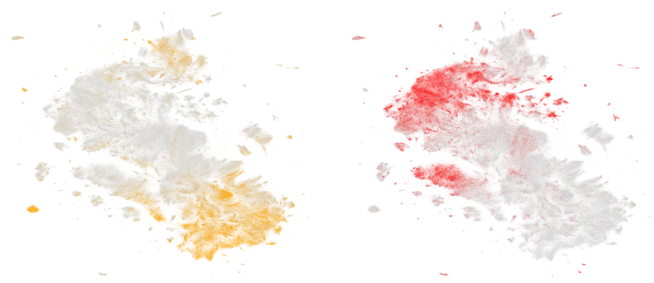
Physics
Biology
Notes:
Similarly, we can compare physics and biology. This time the two fields do not overlap much.

Slide 35
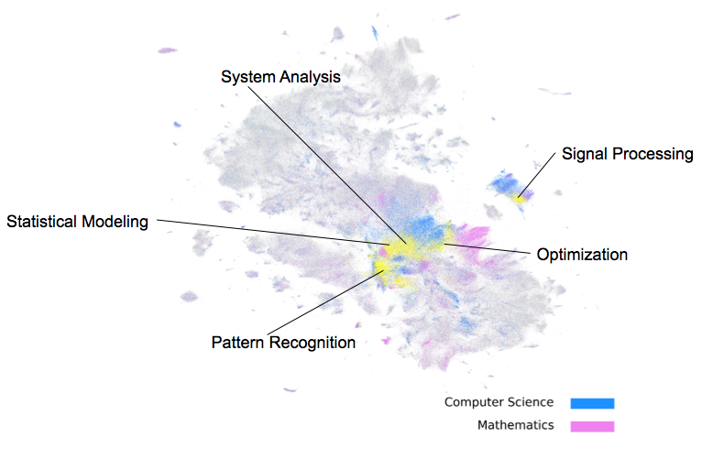
Computer Science vs. Mathematics
Notes:
Coming back to computer science and mathematics. By coloring the overlapped regions differently with the yellow color, we can observe the common topics of the two fields We can see that the most common topics of the two fields are statistical modeling, pattern recognition, optimization, signal processing and system analysis. This is very reasonable, as mathematics provides computer sciences the fundamental theory and analysis tools.

Slide 36
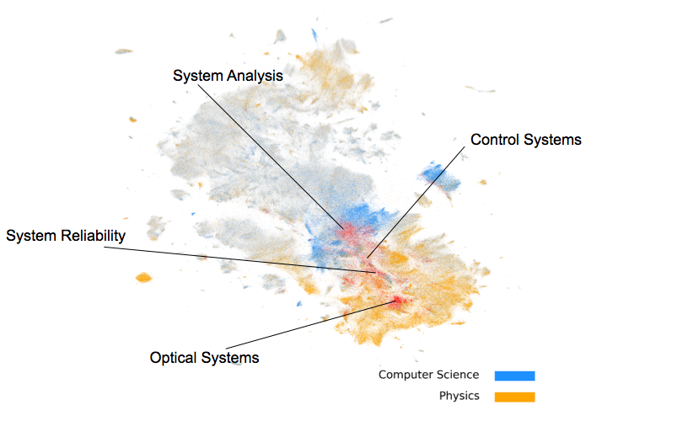
Computer Science vs. Physics
Notes:
What about the overlap between computer science and physics? The common topics between computer science and physics, colored in red, are system reliability, optical systems, control systems and system analysis. You can see all of them are about systems. Note that the topic “system analysis” is shared by all the three fields.

Slide 37
Visualizing Networks and High-dimensional Data
K-Nearest Neighbor Graph (KNN-G)
Construction
….
….
….
….
….
….
….
High-dimensional Data
Networks
2D/3D Layout
How to efficiently construct KNN-G and layout KNN-G?
Notes:
Have some fun? But as mentioned previously, it is very challenging to visualize such large-scale and high-dimensional data since for both stages of K-NNG and K-NNG layout. Next, I am going to introduce our efficient solution to constructing to K-NNG and K-NNG layout.

Slide 38
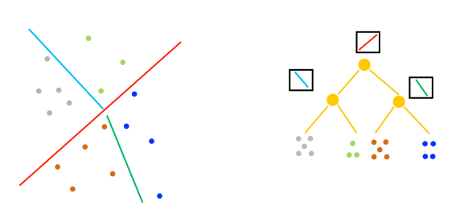
Random Projection Trees
Partition the whole space into different regions with multiple hyperplanes
Notes:
Our approach for K-NNG is based on the state-of-the-art approach of K-NNG: random projection trees. The basic idea is to partition the whole space into different regions with multiple hyperplanes. The whole spaces are organized into a hierarchical tree structure.
Based on the tree, we can efficiently construct an approximate K-NNG.

Slide 39
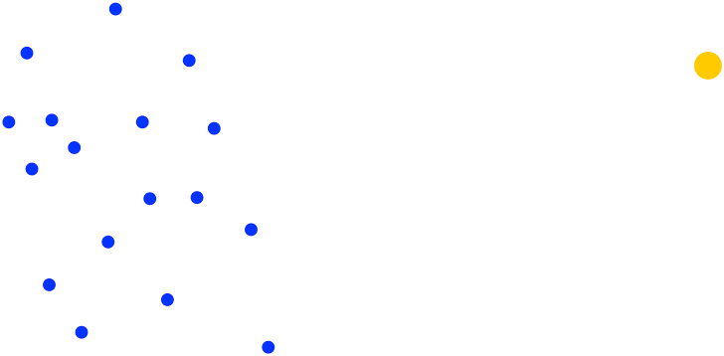
Random Projection Trees
Notes:
More specifically, starting from the entire space, which corresponds to the root node, the algorithm randomly choose a hyperplane and split the whole space into two subspaces, which becomes the children of the root node. By recursively doing this on the leaf nodes, we can partition the whole spaces into many small regions, each of which corresponds to a leaf node in the tree.

Slide 40
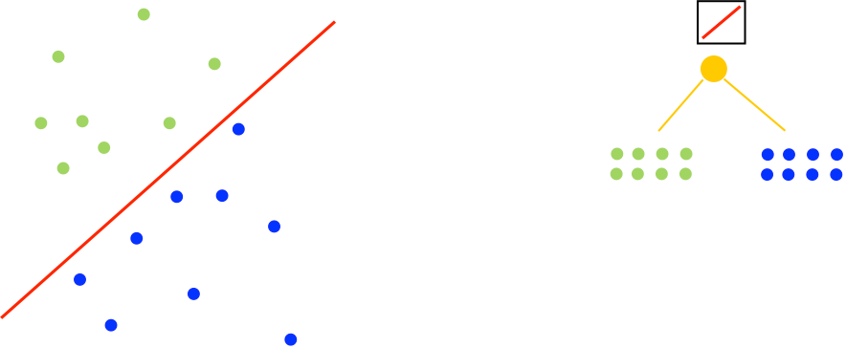
Random Projection Trees

Slide 41
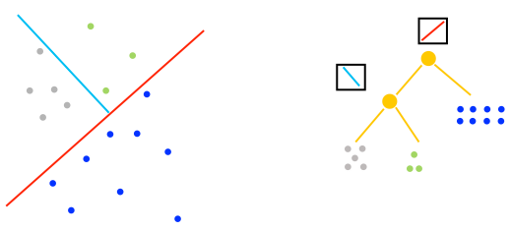
Random Projection Trees

Slide 42
Random Projection Trees

Slide 43
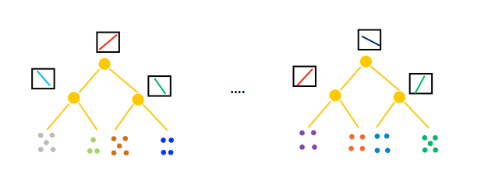
K-NNG Construction
Search nearest neighbors through traversing trees
Only data points in the leaf are considered as nearest neighbors
Multiple trees are usually used to improve the accuracy
e.g., hundreds
Notes:
Once the random projection tree has been constructed, given a data point, we can traverse on the tree to find the subspace it belongs to. Then only the data points in the subspace are considered as the nearest neighbors. Of course, such a randomized algorithm makes many mistakes. In practice, to improve the accuracy of nearest neighbor search, multiple trees are usually used, for example, hundreds of trees. However, building many trees also increases the cost.

Slide 44
Reduce the Number of Trees
Construct a less accurate K-NNG with a few trees
Iteratively refine the K-NNG through “neighbor exploring”
“A neighbor of my neighbor is also likely to be my neighbor”
Second-order neighbors are also treated as candidates of first-order neighbors
Notes:
To reduce the cost of building many trees, we propose a new solution. Instead of building a large number of trees for a highly accurate K-nearest neighbor graph, we start from a less accurate K-NNG, which is constructed with only a few trees. Then we improve the accuracy of the K-NNG with the neighbor exploring technique. The basic idea is that “a neighbor of my neighbor is also likely to be my neighbor”. In other words, we treat the second-order neighbors as the candidates of the first-order neighbors. Does this sound familiar? Think about the second-order proximity in the LINE model.
We iteratively continue this exploring process, which is able to improve the accuracy of the K-NNG significantly while maintaining low cost.

Slide 45
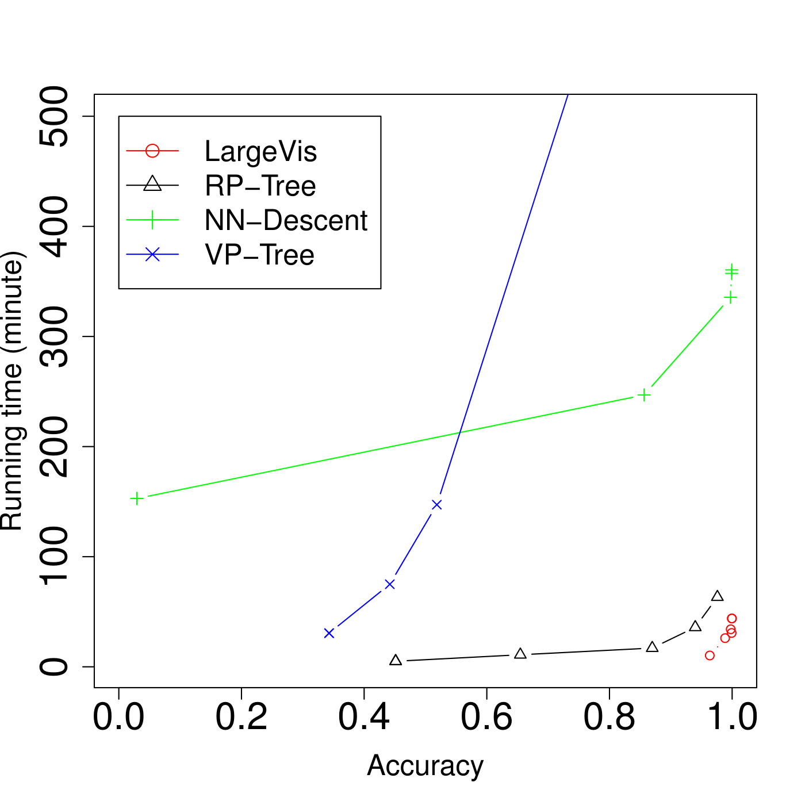
It Works!
X axis: accuracy of K-NNG
Y axis: running time (minutes)
tSNE: 16 hours (95% accuracy)
LargeVis: 25 minutes
>30 times faster than t-SNE
t-SNE
Random projection trees
LargeVis
Notes:
Here are the results of K-nearest neighbor graph construction on three million data sets with 100 dimensions. The a-xis is the accuracy of the K-nearest neighbor graph, and the y-axis is the running time measured by minutes. The lower right corner is the best. Different points in the figure are obtained by using different values of parameters in different algorithms. For example, using different numbers of trees in random projection trees. We can see that our approach LargeVis significantly outperforms tSNE. To construct a very accurate K-NNG, tSNE takes 16 hours while LargeVis takes only 25 minutes, which is more than 30 times faster than t-SNE. LargeVis also significantly improves the efficiency of random projection trees.

Slide 46
Learning the Layout of KNN Graph
Preserve the similarities of the nodes in 2D/3D space
Represent each node with a 2D/3D vector
Keep similar data close while dissimilar data far apart
Probability of observing a binary edge between nodes (i,j):
Likelihood of observing a weighted edge between nodes (i,j):
Notes:
Once the K-nearest neighbor graph is constructed, we need to map it to a two-dimensional or three-dimensional space. The goal is to represent each , making sure that similar data points are close to each other and dissimilar data points stay away from each other.
To achieve this, for each pair of vertice (i, j), we define the probability of observing a binary edge between as the following function. Here yi is the layout of vertex i. If two vertices (I, j) are close to each other, the probability of observing a binary edge between them. Based on this definition, we also define the probability of observing a negative edge, in other words, the probability of not having an edge between two vertices, which is 1 minus this probability. Similarly, the likelihood of observing a weighted edge between vertices (i, j) as follows:

Slide 47
A Probabilistic Model for Graph Layout
Objective:
Randomly sample some negative edges
Optimized through asynchronous stochastic gradient descent
Time complexity: linear to the number of data points
γ: an unified weight assigned to negative edge
Notes:
To preserve the similarities of the vertices, our objective is to maximize the likelihood of the observed edges including both the positive edges and the negative edges. By maximizing the likelihood of positive edges, we can keep similar data points close to each other. By maximizing the likelihood of negative edges, we can make dissimilar data points far away from each other.
As there may be many negative edges, we randomly sample a fraction of them to reduce the computational complexity. The final objective can be efficiently optimized through the asynchronous stochastic gradient descent, and the time complexity is linear to the number of data points, which is very efficient.

Slide 48
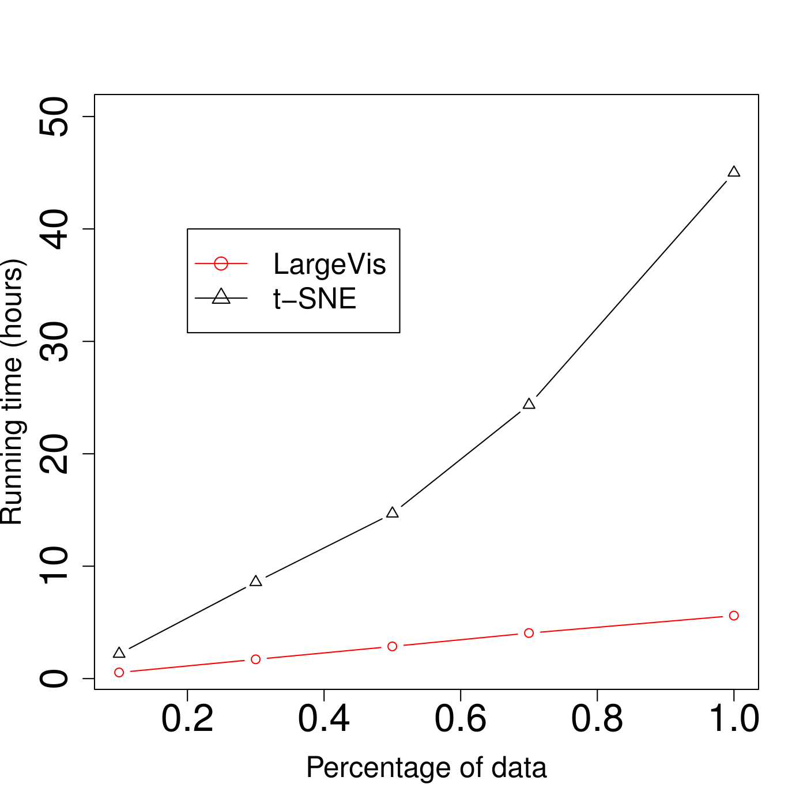
It Works Too!
Time complexity
t-SNE: O(NlogN)
LargeVis: O(N)
On 3 million data points
t-SNE: 45 hours
LargeVis: 5.6 hours
Seven times faster
t-SNE
LargeVis
Notes:
Here we compare the efficiency of graph visualization on the KNN graph between LargeVis and t-SNE. The x-axis is different percentages of random samples from three million data; y-axis is the running time measured by hours. We can see that the LargeVis is much more efficient than t-SNE, especially when the number of data points grows larger. This is because the time complexity of t-SNE is O(NLOGN) while the time complexity of LargeVis is O(N), which is linear to the number of data points. On three million data points, t-SNE takes 45 hours while LargeVis only take around 5hours, which is seven time faster than t-SNE.

Slide 49
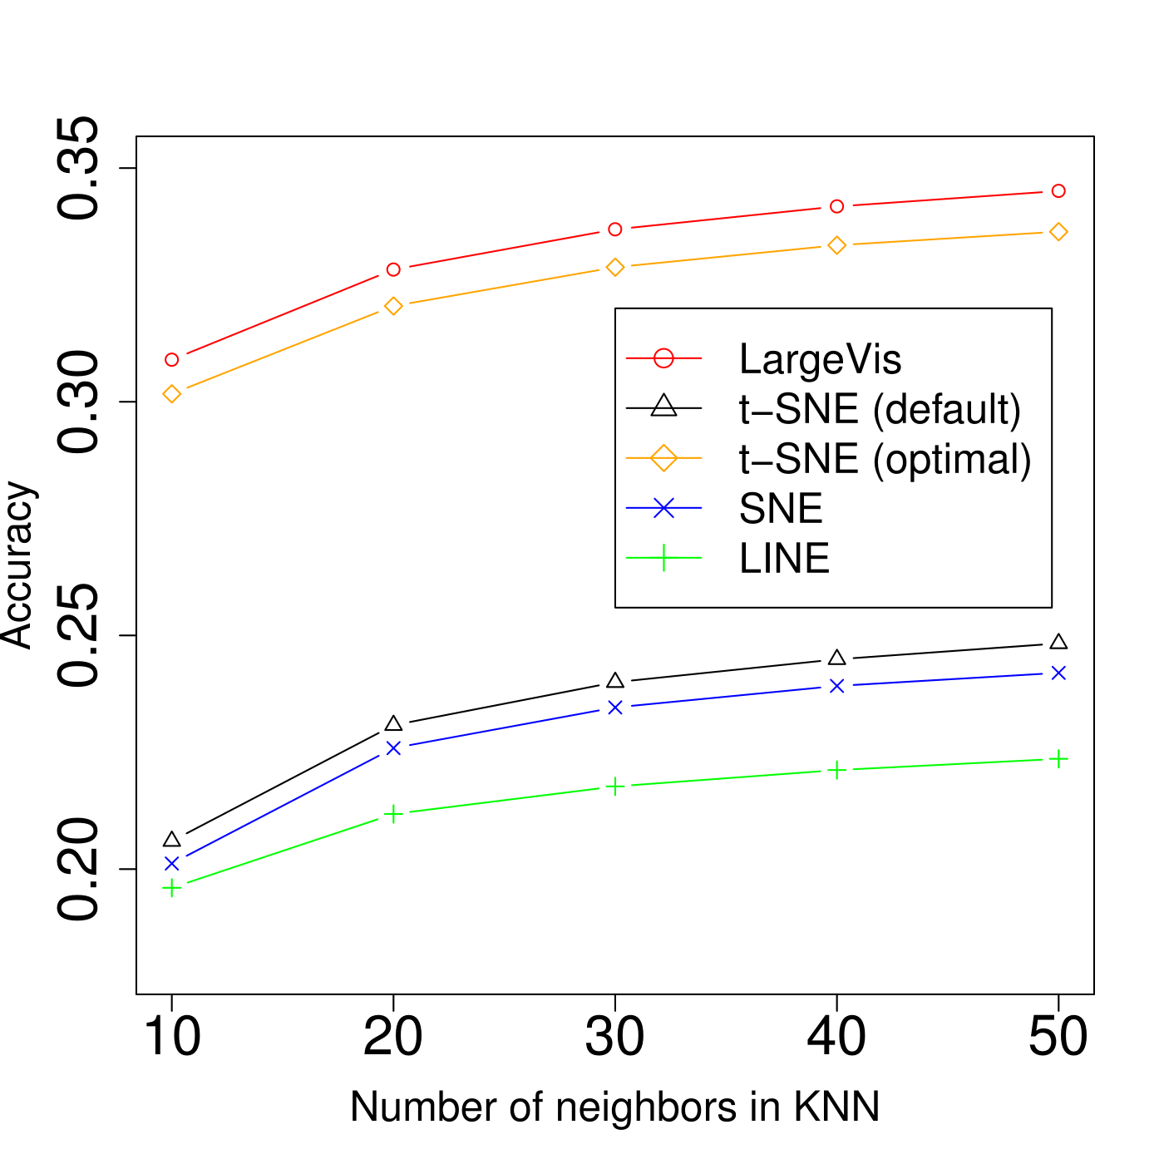
Visualization Quality
LargeVis
t-SNE (optimal parameters)
Metric: classification accuracy with KNN
on 2D space
Configuration:
LargeVis with default parameters
t-SNE with default and optimal parameters
(tuned per data set)
LargeVis t-SNE with optimal parameters
LargeVis >> t-SNE with default parameters
Parameters of LargeVis are very stable
t-SNE (default parameters)
Notes:
We also compare the visualization quality of different algorithms. It is very difficult to measure the visualization quality directly. Intuitively, with a good visualization, data from the same class are close to each other and for clusters. Thereofre, We measure the visualization quality through the classification accuracy of the KNN classifier on the low-dimensional spaces. In this figure, the a-xis is the number of neighbors used in KNN classifier, y-axis is the classification accuracy. For LargeVis, we use the default parameters. For t-SNE, we use both the default parameters and parameters empirically tuned on different data sets, which is very computationally expensive. We can see that LargeVis with default parameters slightly outperforms tSNE with optimal parameters but significantly outperform t-SNE with default parameters. However, empirically turning the optimal parameters on big data sets is very expensive. In many data sets of our experiments, we observe that the parameters of LargeVis are very stable while the parameters of t-SNE are very sensitive.

Slide 50
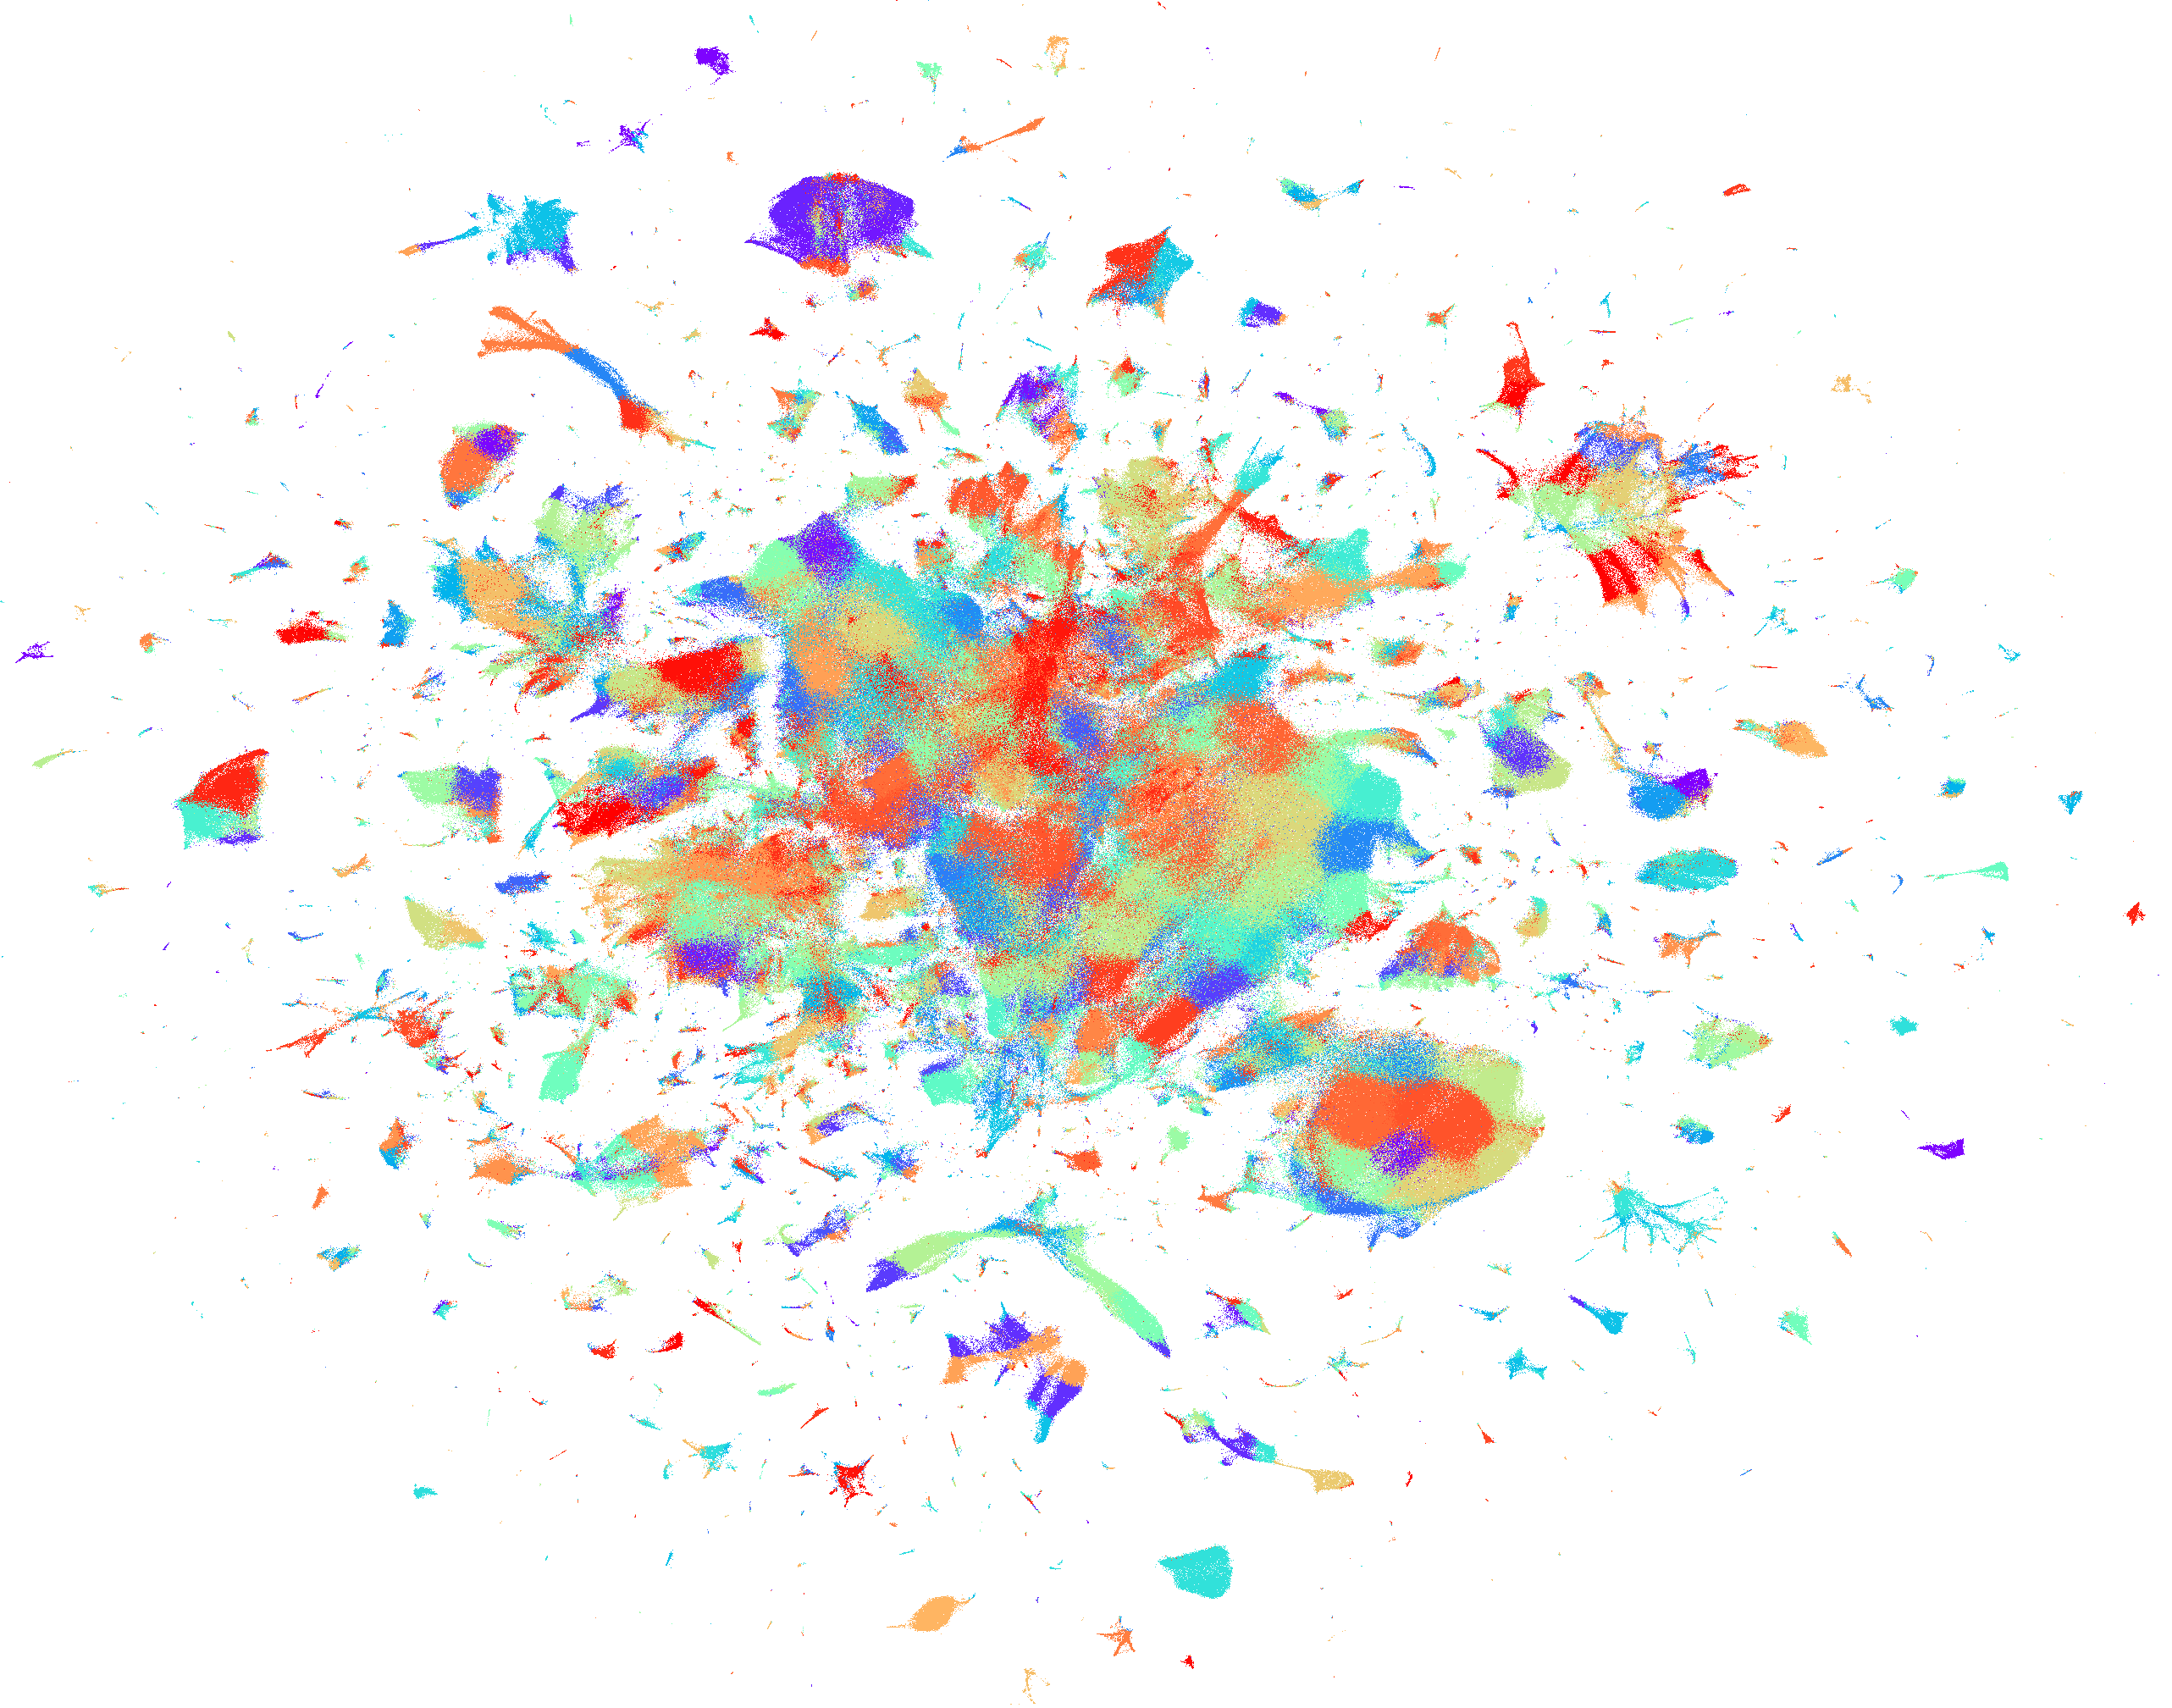
Wikipedia Articles
(color: semantic cluster)
Notes:
Lets look at some other visualizations generated by LargeVis. This is a visualization of three million Wikipedia articles. Every data point is a node. each color represents a semantic cluster of Wikipedia articles.

Slide 51
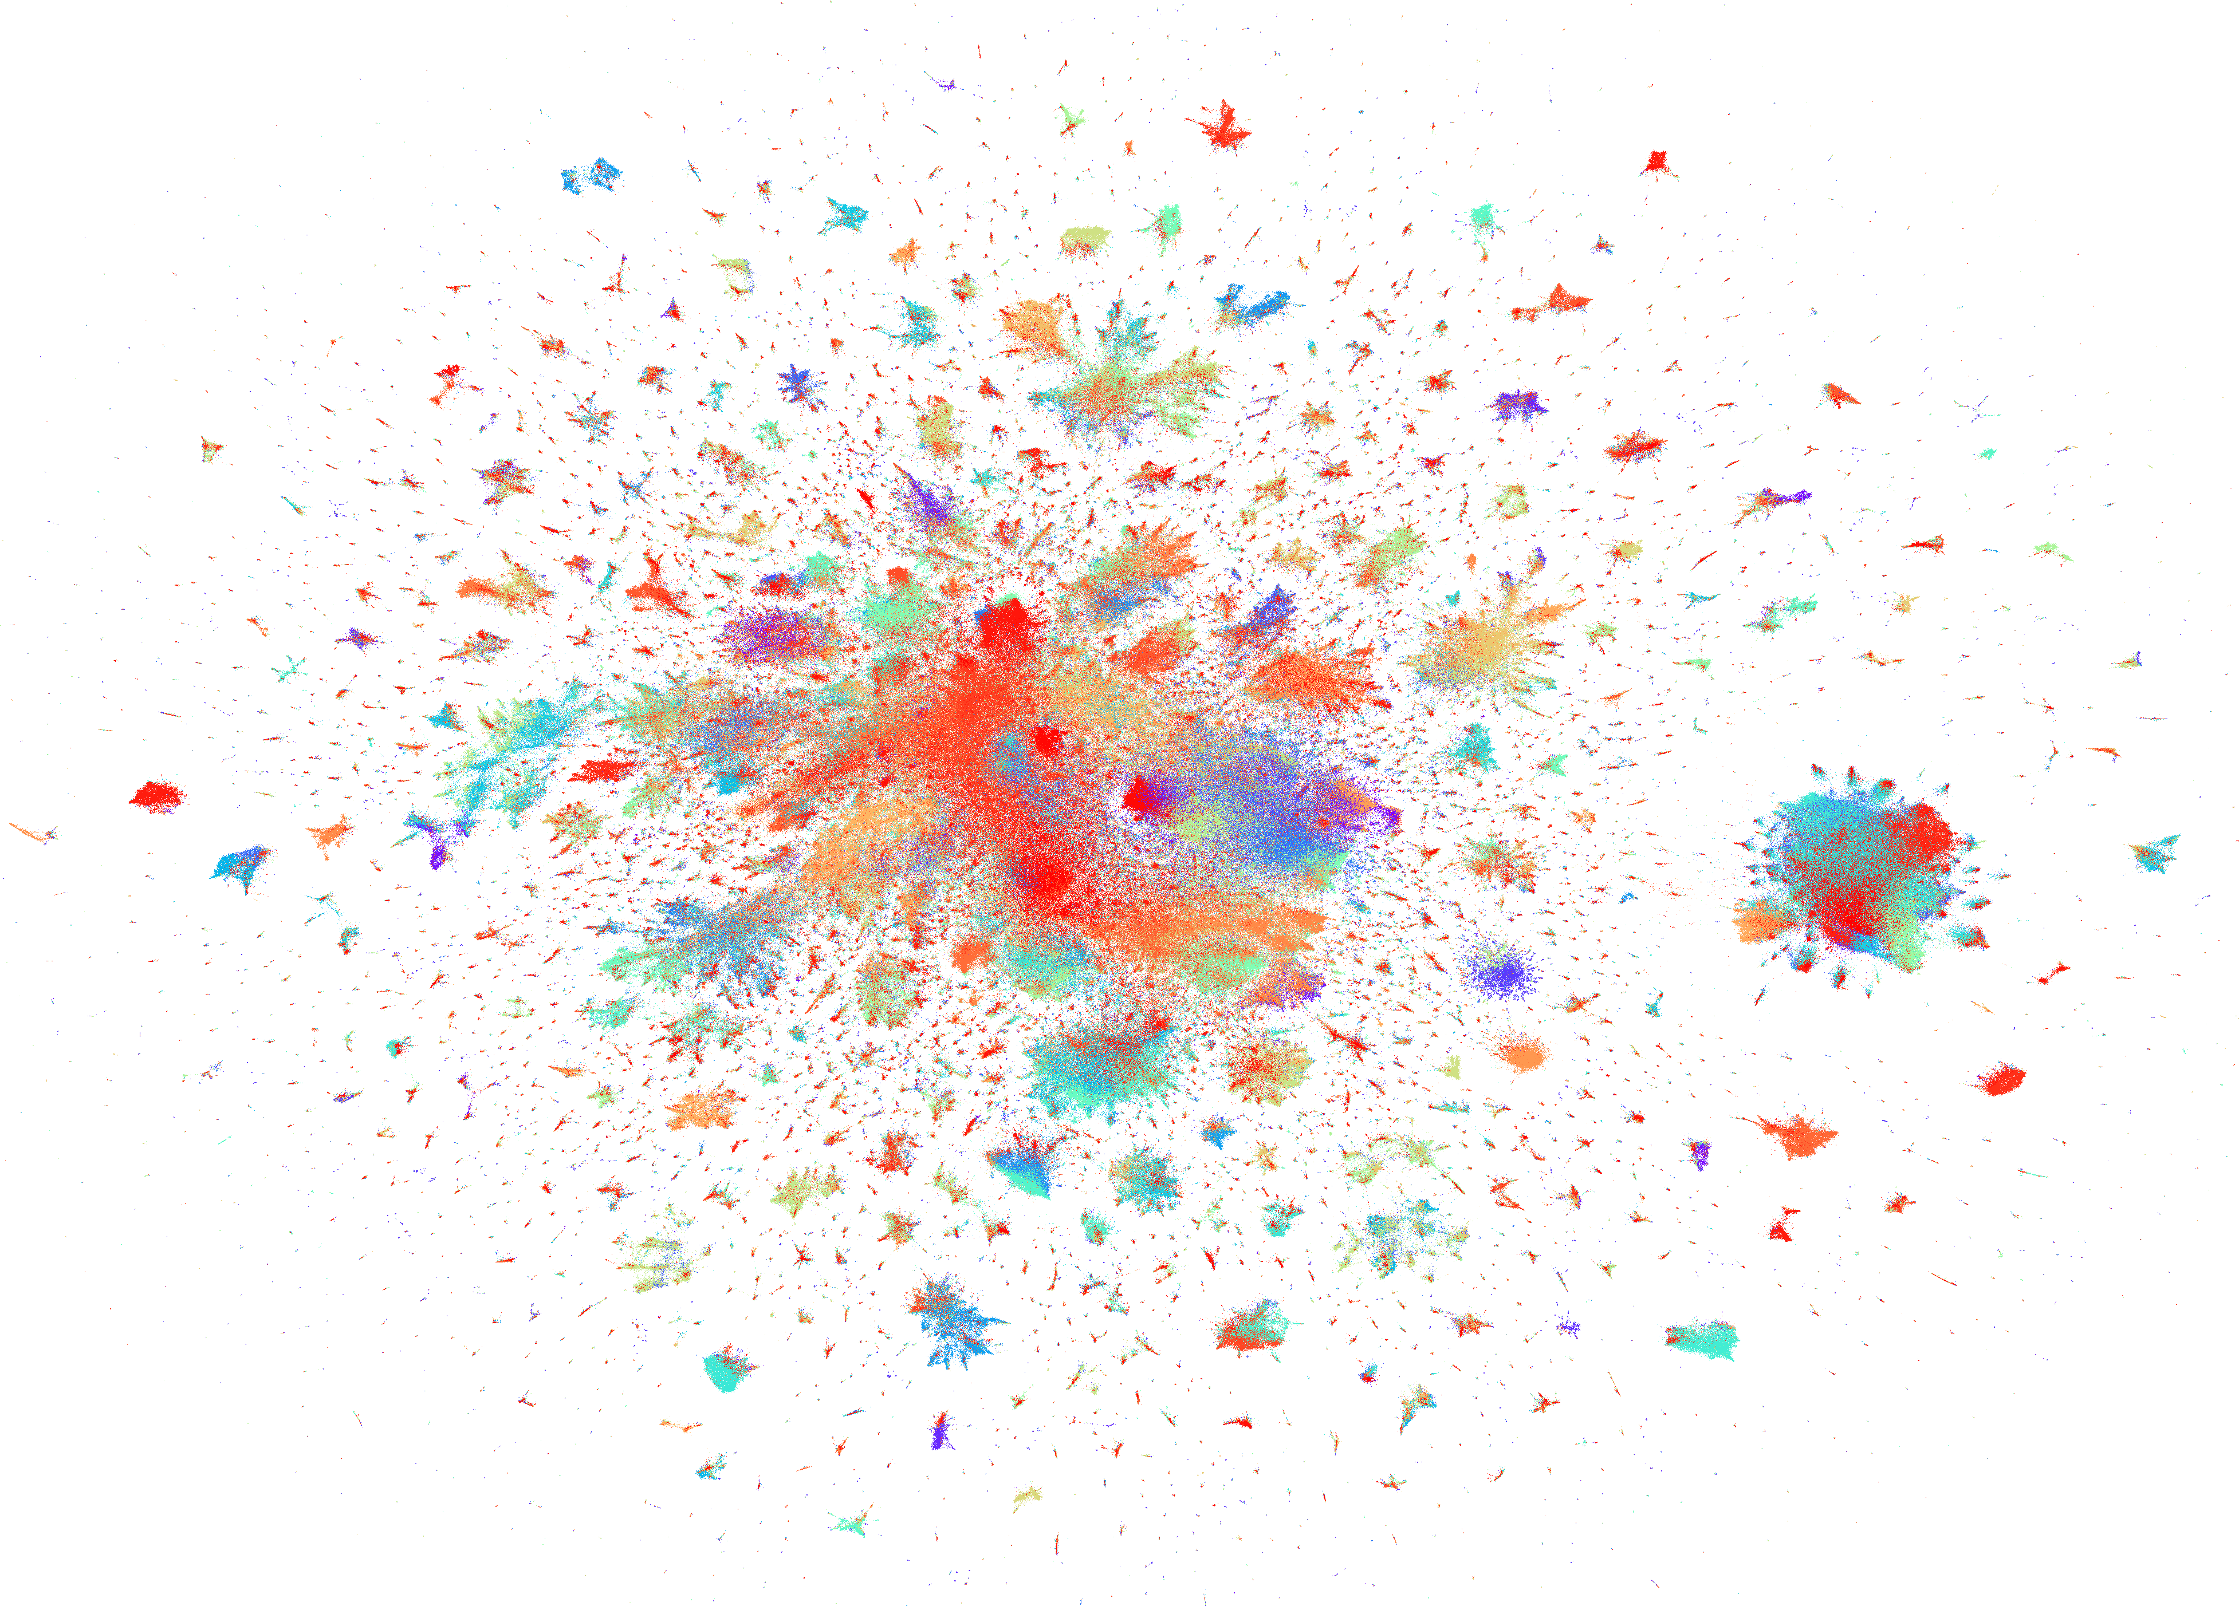
LiveJournal Network
(color: community)
Notes:
This is a visualization of the LiveJournal network, which contains 4 million nodes. Every data point is a node, and each color corresponds to a community.

Slide 52
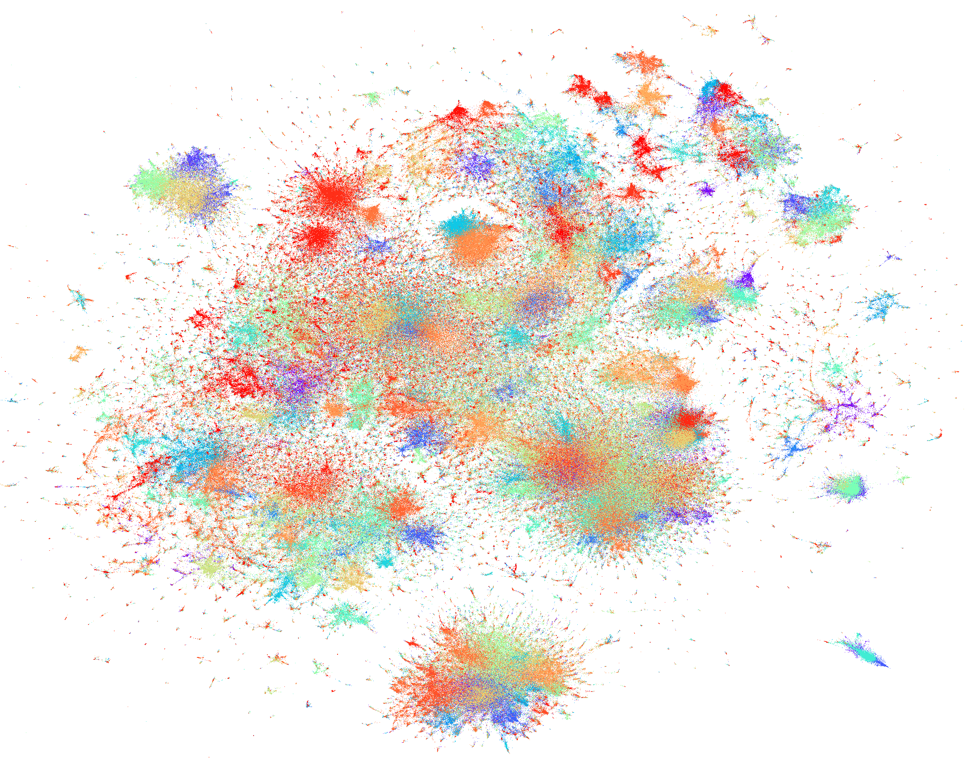
Computer Science Authors
(color: community)
Notes:
This is a visualization of 1 million computer science authors. Every data point is an author, and every color is a community.

Slide 53
Summary
LargeVis: a new technique for visualizing networks and high-dimensional data
A better tool than t-SNE.
>7 times faster than t-SNE on three million data points
Notes:
To summarize, in this project, I propose a new visualization technique called LargeVis, which is able to visualize both networks and high-dimensional data. It is a better tool than tSNE, which is more than seven times faster than t-SNE on three million data points. I actually suggest you to use LargeVis to visualize your data in the future.

Slide 54
Impact
Our release:
LINE:
(C++)
https://github.com/tangjianpku/LINE
(271 stars, released since 2015.3)
LargeVis :
(C++&Python)
https://github.com/lferry007/LargeVis
(289 stars, released since 2016.7)
Other tools based on our implementation:
R version in CRAN:
https://github.com/elbamos/largeVis
LargeVis Tutorial:
https://jlorince.github.io/viz-tutorial/
Interactive Visualization:
https://github.com/NLeSC/DiVE
…
Notes:
Both the source codes of LINE and LargeVis are released and received a lot of attention. There are also many other open source implementations or tools based on our release. To name a few, there is an R implementation of LargeVis released in the official repository of CRAN. There is a python tutorial on how to visualize high-dimensional data with LargeVis from scratch. There is a interactive visualization tool to explore high-dimensional data based on LargeVis. LargeVis can be particularly useful in understanding deep neural networks by visualizing the representations learned by neural networks.

Slide 55
Roadmap
Learning Node Representations
for Networks
Visualizing Networks
Future Plan
Notes:
Now I will talk about my future plans.

Slide 56
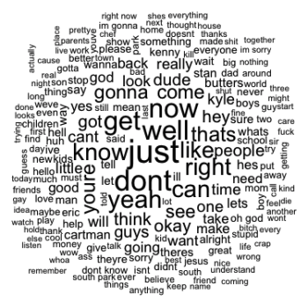
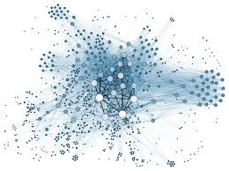
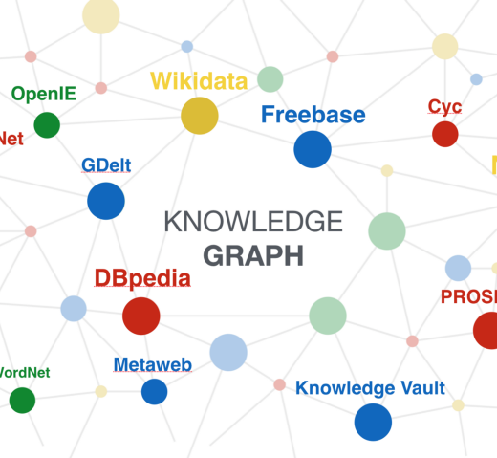
Social media
Social networks
NLP
(e.g., Question Answering)
Information Retrieval
Recommender Systems
Text
Networks
Knowledge Graph
Deep Generative Models
Memory & Attention
Deep Reinforcement Learning

Slide 57
Take Away
LINE: learn continuous representations of nodes in networks
LargeVis: visualize networks and high-dimensional data
Next steps:
Deep generative models
Attention & Memory
Deep Reinforcement Learning
Notes:
To wrap up, in this talk, I talked about learning representations of large-scale networks. I proposed a scalable algorithm called LINE to learn the node representations. I proposed an algorithm called LargeVis to learn extremely low-dimensional representations to visualize networks as well as high-dimensional data. In the future, I am interested in applying or developing representation learning algorithm for analyzing different user behaviors. I’m interested in developing deep learning techniques for learning whole network representation and also natural language understanding in medical domain.

Slide 58

Welcome to Join MILA
Hiring Ph.Ds, Masters, Interns, and Visiting students
One of the largest group in academic working on deep learning

Slide 59

tangjianpku@gmail.com

Slide 60
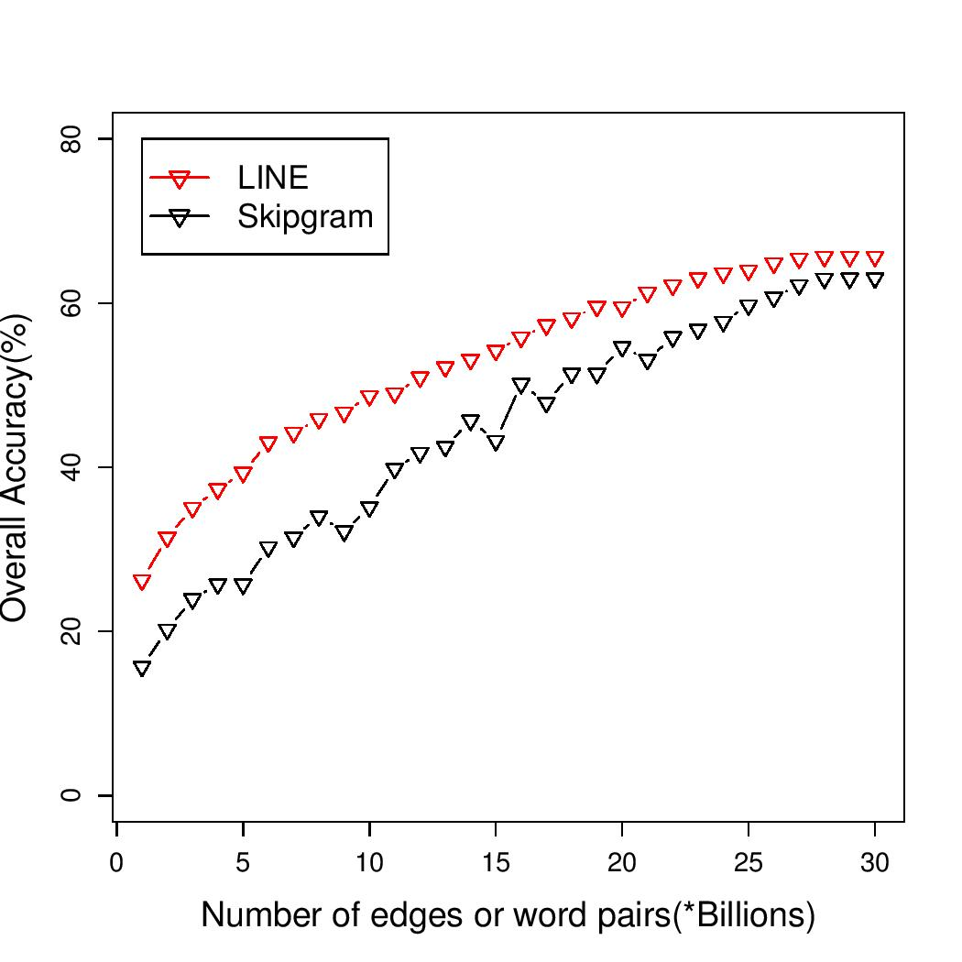
Performance w.r.t. Number of Samples (Word Cooccurrences)
Notes:
More specifically, we compare the converging performance of LINE with second-proximity and Skipgram. In this figure, the axis is the number of word cooccurences, which are the training data for learning word representations and the y-axis is the overall accuracy. We can see that the performance of LINE consistently outperforms Skipgram. We can also that the performance of LINE is very stable when the number of word cooccurrences increase while the performance of Skipgram is unstable when the number of word cooccurrences increases.

